Slide 1

Solution Design: Completing a Prototype
Notes:
Speaker Notes:
Introduce yourself (name, major, maybe a fun fact!)
In this workshop, we’ll be discussing and practicing skills around designing a solution within a series of constraints.

Slide 2
UNDERSTAND
DEFINE
SKETCH
DECIDE
PROTOTYPE
VALIDATE
Notes:
Speaker Notes:
Today we’re going to do an exercise called a design sprint, which outlines six steps to designing any solution.
First, we aim to understand and define. Specifically, we want to understand/define the problem and the user who’s faced with this problem.
Next, we’ll sketch and decide. For this step, we’re going to be ideating on ideas using pictures -- don’t worry if you’re not an artist, you’ll be just fine! -- and decide on which idea is “best” as a team.
Lastly, we prototype and validate. This is when we build a paper prototype and use it to test our assumptions.
Oh and by the way, this exercise is usually done with product teams over the course of a 5-day work week, but we’re going to sprint through it in a few hours :)

Slide 3
design sprint: five part workshop
Part 1 [10 mins] | Part 2 [8 mins] | Part 3 [5 mins] | Part 4 [20 mins] | Part 5 [20 mins] | Part 6
Map the Problem | Sketch | Decisions | Prototype | Test | Demo
Notes:
Speaker Notes:
So what will this workshop actually look like?
First, we’ll break up into teams -- and all of this will be done in that team.
For Part 1, we’ll try to identify the user and map out their problem.
For Part 2, we’ll sketch solutions on a piece of paper using a method called “crazy eights.”
For Part 3, we’ll vote on which idea to go with.
For Part 4, we’ll use the Marvel app (https://marvelapp.com/) to create usable prototypes out of paper mock-ups.
For Part 5, we’ll test it out on each-other and see what we learn.
Lastly, in part 6, we’ll all take a moment to demo and celebrate what we’ve accomplished :)

Slide 4
Write the Solution Challenge SDG’s your team will be using and the problem you plan on solving below:
Type problem here!
Notes:
Speaker notes:
The point of this workshop is to help us actually solve a problem, and for the sake of the exercise, lets say this is the problem we want to solve: it’s hard to buy hats and glasses virtually and ensure that they look and feel good while being worn.

Slide 5
Map out your Intended user below:
This can be typed or a photo!
Example of HUNGR map is on the next slide!
Notes:
Speaker notes:
In the first step of solving this problem, we’ll try to identify the user and map out their problem.
This will be a 10 minute activity where we’ll create 2 user personas. Each team should take two pieces of paper and a marker. Together, draw a picture of your user and give them a name -- yes, this is actually important because it helps you communicate about the personas. Then, write down a few characteristics that’ll help define them as a user of your product.

Slide 6
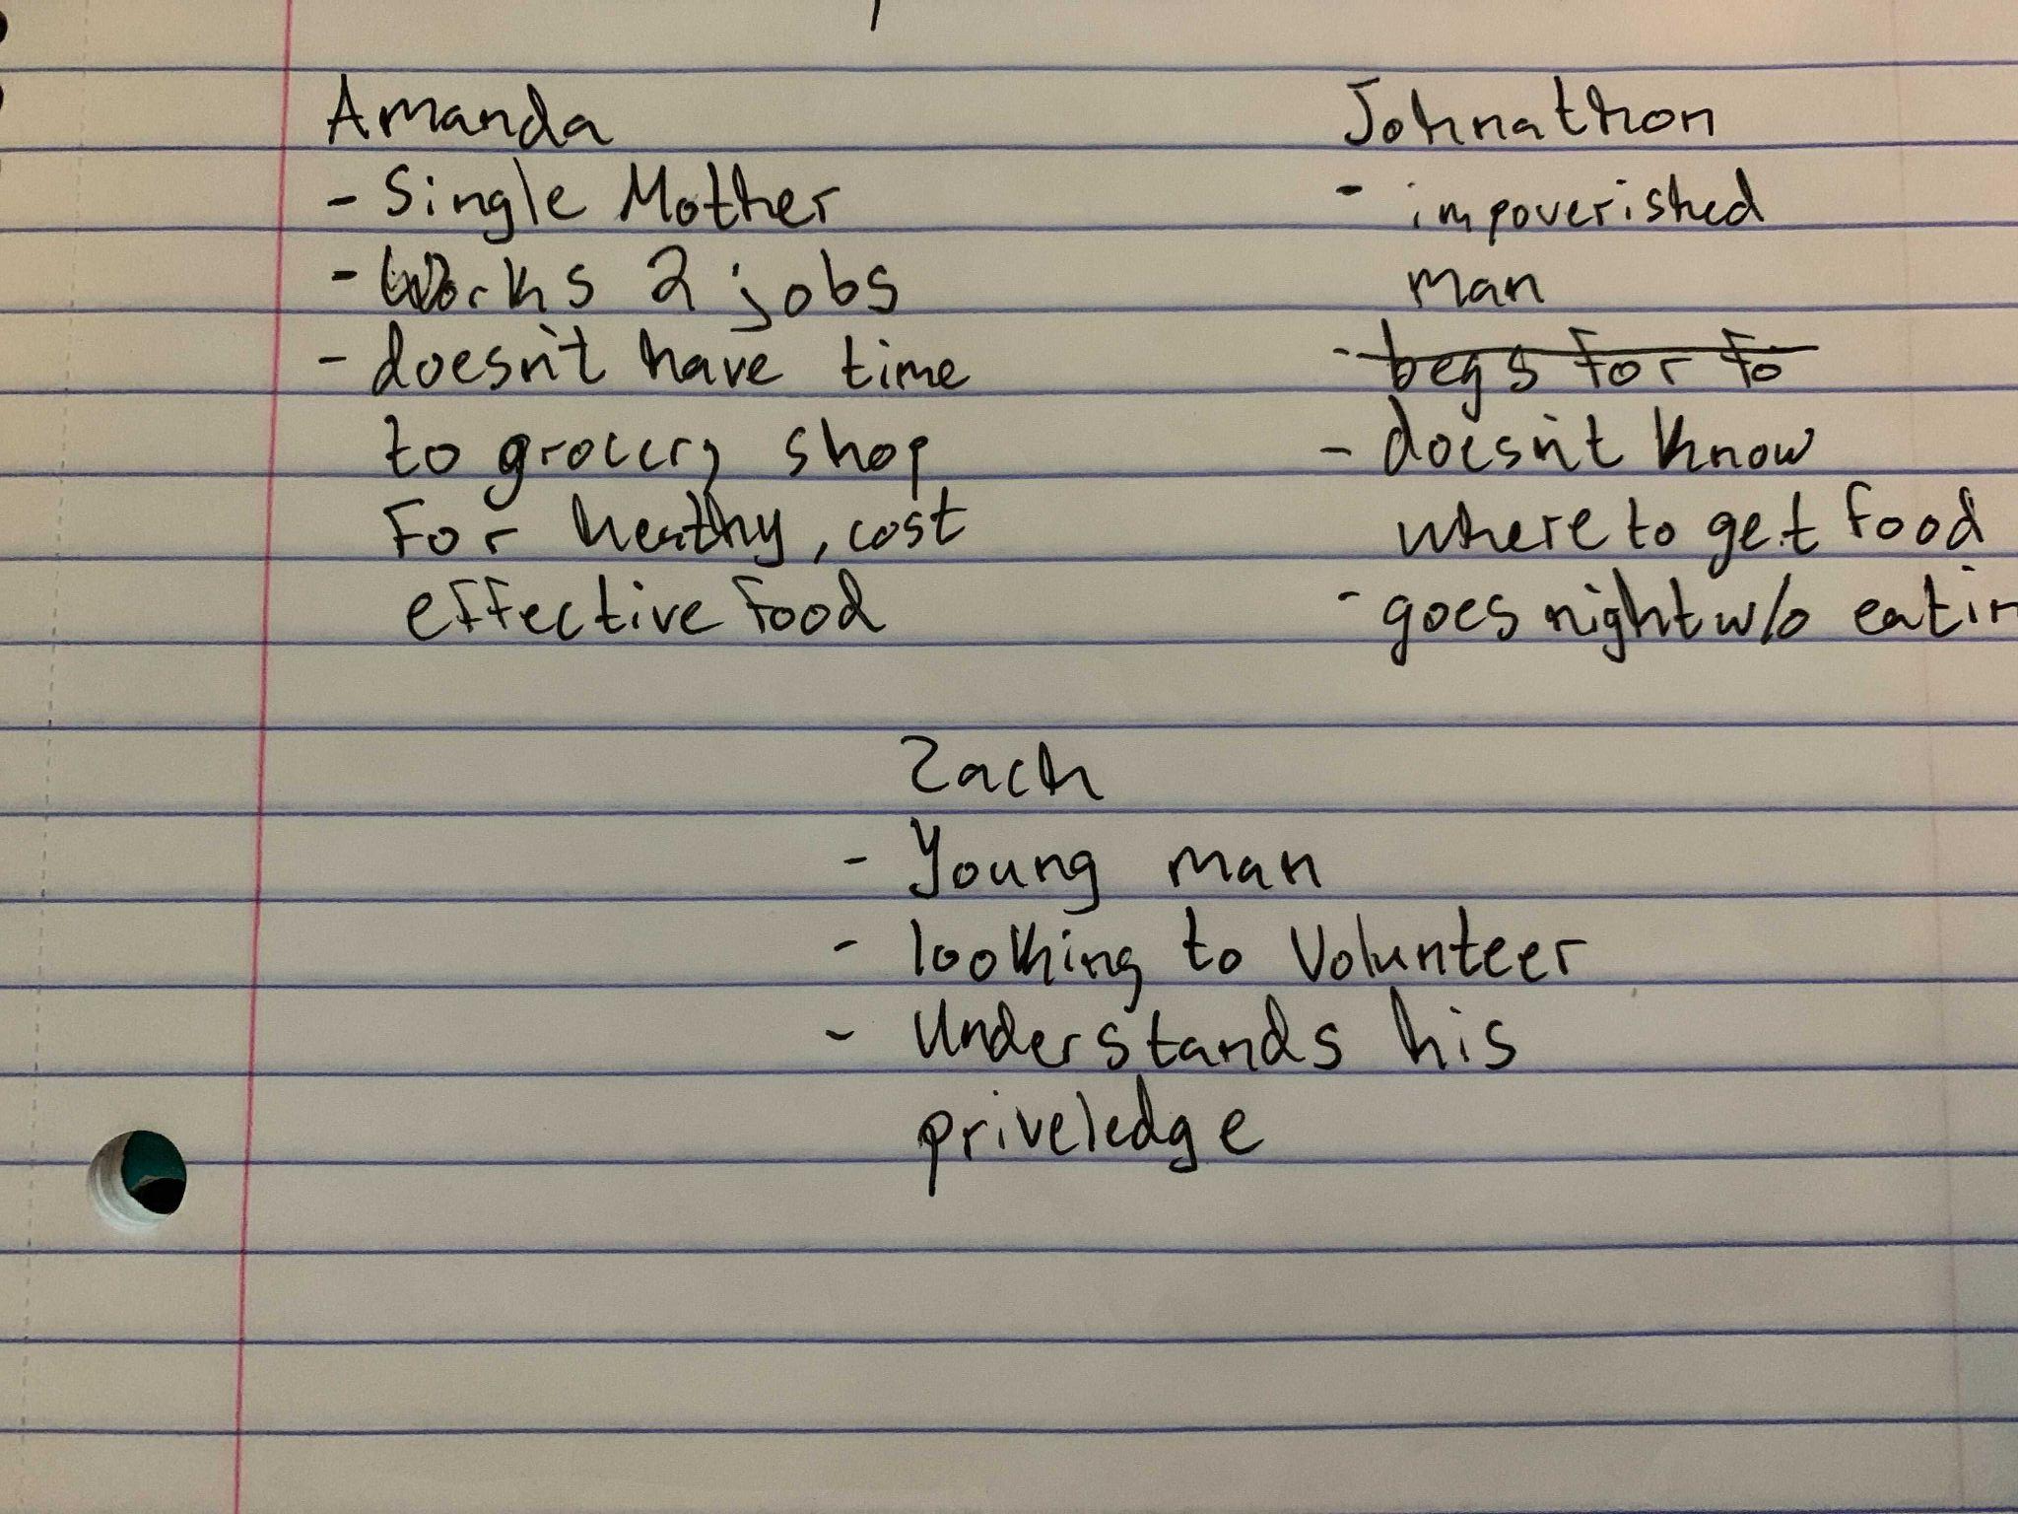

Slide 7
Sketch a Golden path for you’re user:
This can be typed or a photo!
Example of HUNGR map is on the next slide!
Notes:
Speaker Notes:
For Part 2, we’ll be doing “crazy eights.” Each member of the team should take a piece of paper and fold it up like you see on the screen. In 8 minutes, each member should write an idea down in each rectangle, generating eight ideas -- hence, the name “crazy eights.” When you’re generating these ideas and writing them down, try and keep in mind the problem and the user, but be sure to draw or write down any ideas that come to your mind, completely unfiltered -- this will help keep the creative juices flowing!

Slide 8
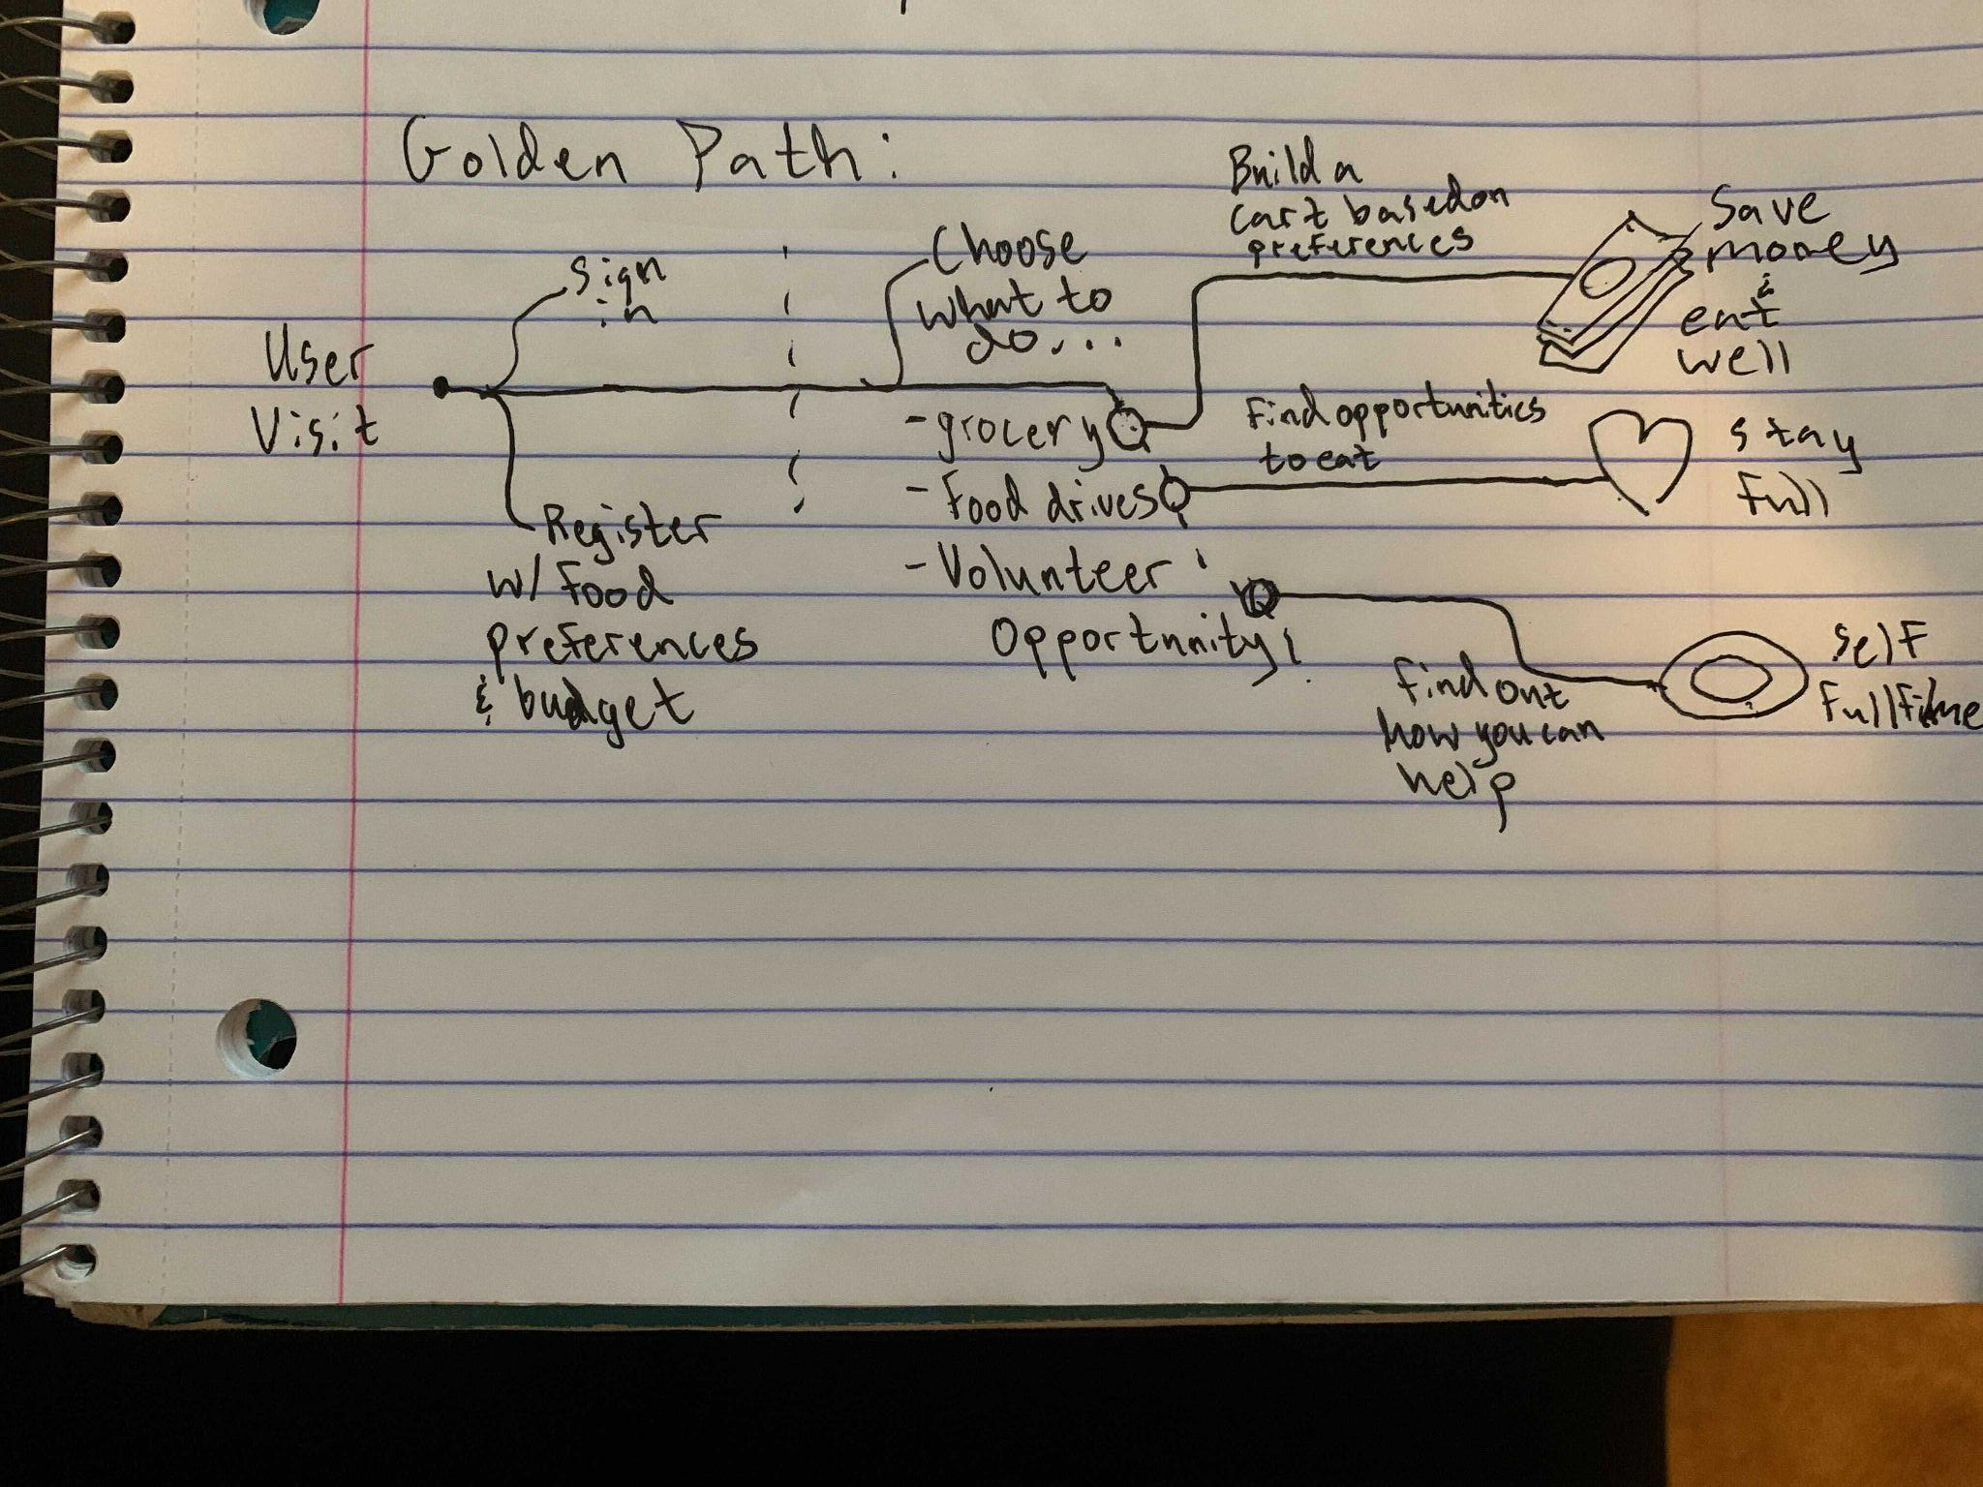

Slide 9
Crazy 8’s Sketch:
In the Crazy 8’s Sketch get together with your team and fold a paper in 8 sections. If you can only meet virtually load a google jam board and divide it into 8 sections. Set a timer for 8 seconds and begin sketching a design for your application!
This can be typed or a photo!
Example of HUNGR map is on the next slide!
Notes:
Speaker Notes:
Next, put all of the ideas down on a table or up on an easel -- it’s time to vote! We’ll be the using dot-voting system and each member gets 3 votes -- they can vote for whatever they want as many times as they want. The idea with the most votes wins!

Slide 10
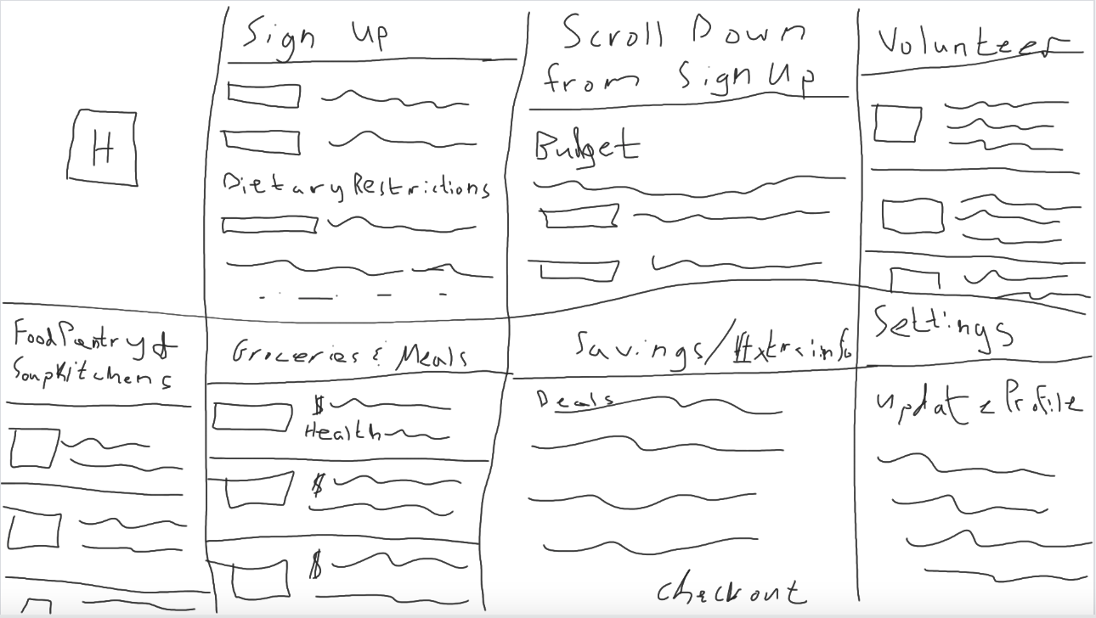

Slide 11
Prototype with application flow and purpose:
Does not need to be completely in depth. Have a scribe draw the prototype and nail down 3-5 key moments when using the application and think about what it will look like and do. It doesn’t need to be complete flow, map out the most important places in your application.
This can be typed or a photo! A great online tool to help build a prototype is Miro.com!
Notes:
Speaker Notes:
Now that we have an idea, its time to prototype. As a team, you should decide what the different views in the product should be. Then, draw them out with a marker on paper and use the “Marvel” app to string them together into a usable, testable prototype. You have 20 minutes for this step!

Slide 12
Testing:
Ask your friends and club members to listen to your solution pitch! Record everything they have to say and don’t be upset if they are harsh! All feedback is good!
Prepare a short pitch for your peers!
Let me know if you want the transcription of the HUNGR Pitch or any other useful things!
Notes:
Speaker Notes:
At step, 5, we’ll be almost done. We have a prototype and it’s time to test. To do this…
First, split your team up in half.
Then, each half-group should find another half-group (of course, this half-group should be from a separate whole-group).
Each half-group should take turns testing their prototype on each other.
You should have time for each half-group to test and be tested TWICE, meaning that the whole group has tested the prototype FOUR times.
Once you’re done testing, come together and discuss your learnings.

